Slide 1

Web APPLICATION Development (111834)
Dr. Owais Hussain

Slide 2

Agenda
History
Overview of the Client-side
Content, Styling, Interaction
Overview of the Server-side
Modern Platforms, Languages and Tools

Slide 3
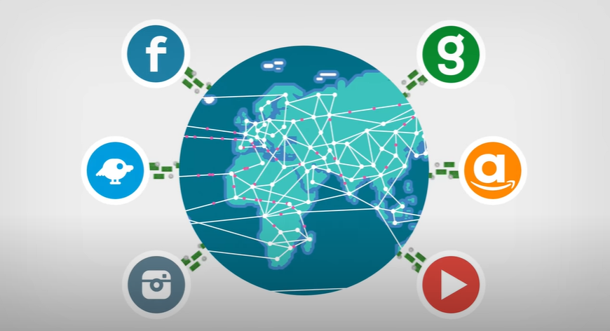
Brief history of the web
So… who invented the internet?
By a British engineer in an underground lab of Switzerland.
By USA’s DoD to create a network with ability to sustain a nuclear war.
By a French scientist who coined the term “Le Internet”
Or was it an unorganized, joint venture, pieced together in 40 years?
The internet is a bunch of connected computers; WWW is a way to share the content on these computers.
Notes:
Who Invented the Internet? And Why? - YouTube

Slide 4
Brief history of the web
1960’s: ARPANET created first network for scientists to share mainframes.
1965: National Physics Lab at UK invents packet switching to cut up data in packets.
1970: CYCLADES, a French network connected computers directly. They coined the term “Inter. Net”
1972: ARPANET invents Electronic Mail.
1975: TCP/IP protocol is created to ensure packets arrive at the right destinations.
1980’s: Timothy Lee, a British scientist working for European Nuclear Organization, CERN, created first interface using HTML, HTTP, and URL’s for scientists to share information easily. He called it WWW.
1991: the first Website is created by CERN in France.
1990’s: telecom companies join the bandwagon. Web browsers start spreading.
1995: the internet is ready for mass adoption.
Notes:
Who Invented the Internet? And Why? - YouTube

Slide 5
Brief history of the web
1995: JavaScript is invanted by Brenden Eich for Netscape 2.
1996: CSS is released by W3C (WWW Consortium).
1998: HTML 4.0 is materialized, and Microsoft is the fastest to adopt.
2004: Internet Explorer has a peak market of 92%.
2010: Google Chrome, Mozilla Firefox, Apple Safari, Opera, are all competing for browser market.
2011: Twitter releases Bootstrap, the most popular responsive CSS library.
2013: Facebook releases ReactJS, a fully JavaScript based library for web development
2014: W3C completes the HTML-5 standard specifications.
2015: ECMAScript – 6 (ES6) for JavaScript is released, which was fully incorporated by major browsers by 2018.
Current: SPAs, JS frameworks, 5G, Edge computing, Web Assembly, Web3, NFT, Crypto, AI, …………….
Notes:
Who Invented the Internet? And Why? - YouTube

Slide 6
Overview of the Client-Side
Web Browser as the go-to software
Any OS; any Hardware; any type of Network
Protocols are fixed:
HTTP/HTTPS: Hypertext Transfer Protocol
Gopher: Protocol for content delivery over IP, before WWW
FTP: File Transfer Protocol
Once the Server delivers the content, everything happens on client’s computer
Some corners can be cut in code quality, documentation, resource optimization
Zero compromises on UI/UX
Notes:
Web browser is the only software needed by the client (user) to access the web content
Gopher was a protocol before World Wide Web. It made searching and distributing content possible over Internet Protocol

Slide 7
Content, Styling, Interaction
Web Browser: one software for all
HTML: the content carrier in XML format
CSS: presenting it all in style.
JavaScript: making interaction possible
Disclaimer: JavaScript and Java are totally different languages

Slide 8
Overview of the Server-Side
Server: A computer; Web Server: software service hosted on that computer
NOT an OS
Assume the Web to be a Restaurant:
Server serves the Menu (a Website). Client orders food (HTTP Request). Server receives the order (GET/POST). Understands it and tells the Chef to Cook (Content). Chef cooks the food requested (Database and Service operations). Chef tells the Server to pick up the food when ready. Server serves the food to client (HTTP Response). Client uses the utensils (Web Browser) to consume the food.
Laser focus on resource optimization
Isolation of Business Logic
Apache Tomcat, NGINX, IIS

Slide 9

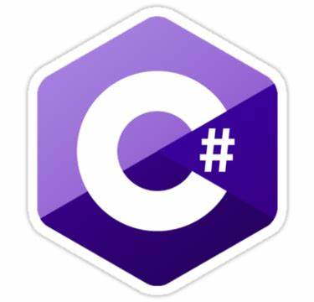


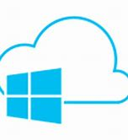




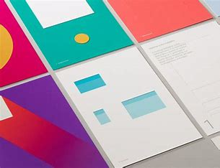








Modern Platforms, Languages and Tools
Microsoft world
Typescript, C#, VS-Code, ASP.NET, Azure
Google world
AngularJS, Chromium/DevTools, Material UI, Flutter, Google Cloud
Java world
Spring, Hibernate, JSP, Vaadin
PHP world
Xampp, Laravel, Codeigniter
The rest of the world?

Slide 10
Modern Platforms, Languages and Tools we will use
Python: Language of the Data; easy to learn; plenty of support
Django: Complete framework; stable; minimal boilerplate code
JavaScript: Language of the web; variety of tools/libraries; >>fast (wanna debate?!)
Bootstrap: Top CSS library by Twitter
PostgreSQL: High-performance; Scalable; RDBMS; Supports Document types
Postman: REST API testing (and even documentation)
Visual Studio Code: Overall the most feature-rich IDE; highly integrated; Light-weight; many platforms

Slide 11
Use Case
Initiate a project called “Dareecha” (gateway/portal), which will provide several applications to students of KIET.
We will be designing the first app “baham” (together) for this portal.
This app will be ride sharing service to facilitate students, staff and faculty commuting from distant areas, by allowing them to share their ride.

Slide 12
Let’s set things up
Make sure all the tools are installed
Create groups based on Merit and choose a leader
Group leaders to create a repository on Github called “Dareecha”
Create a Scrum board on Jira or Trello
Sign-up on Slack

Slide 13



THANK YOU
Owais Hussain
+92 345-3174270
owais.hussain@kiet.edu.pk
https://www.researchgate.net/profile/Owais-Hussain-3

